Slide 1

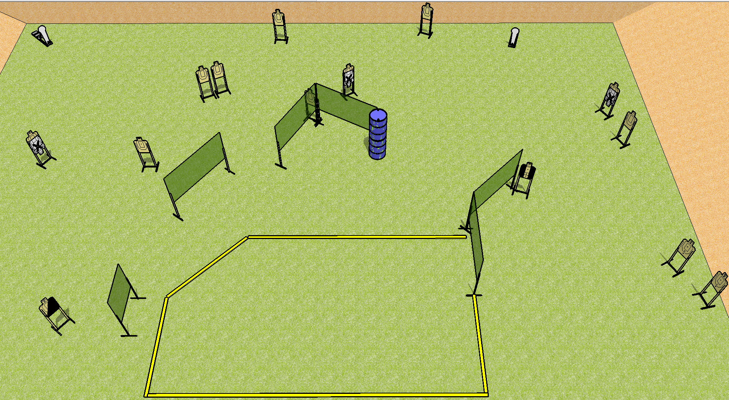
 | Dothan Practical Shooters – USPSA Match What’s Up Dog Course Designer : Drew Coleman Bay: B2
Round Count 30 rounds 14 USPSA 2 colt poppers
Equipment List 11 wall feet 1 tux, 1 right diag 15 paper (12 + 3 NS) Rear fault line 30’ across, front is 24, 10’ for the others

Slide 2
What’s Up Dog
Written Stage Briefing
Scoring: Comstock Rounds: 30 rounds
Targets: 14 USPSA, 2 steel
Handgun start position: anywhere inside the shooting area, wrists below belt. Handgun is loaded and holstered.
PCC start position: anywhere inside the shooting area, stock on belt. Loaded carbine is held with both hands, safety on.
Stage Procedure: on the audible start signal, engage targets as they become available from within the shooting are.

